Slide 1


CREATING AMAZING VISUALISATIONS WITH SAS® STORED PROCESSES AND JAVASCRIPT LIBRARIES
Phil Mason
Independent SAS Consultant
Did you know?
SAS University Edition includes the SAS 9.4 products Base SAS®, SAS/STAT®, SAS/IML®, SAS/ACCESS® Interface to PC Files, and SAS® Studio. Runs in a Virtual Machine on PC, Mac or Linux. And you can download it for FREE!!!
http://www.sas.com/en_us/software/university-edition.html
Notes:
SAS University Edition is Free!
Little puzzles in bottom right corner will show up now and then

Slide 2

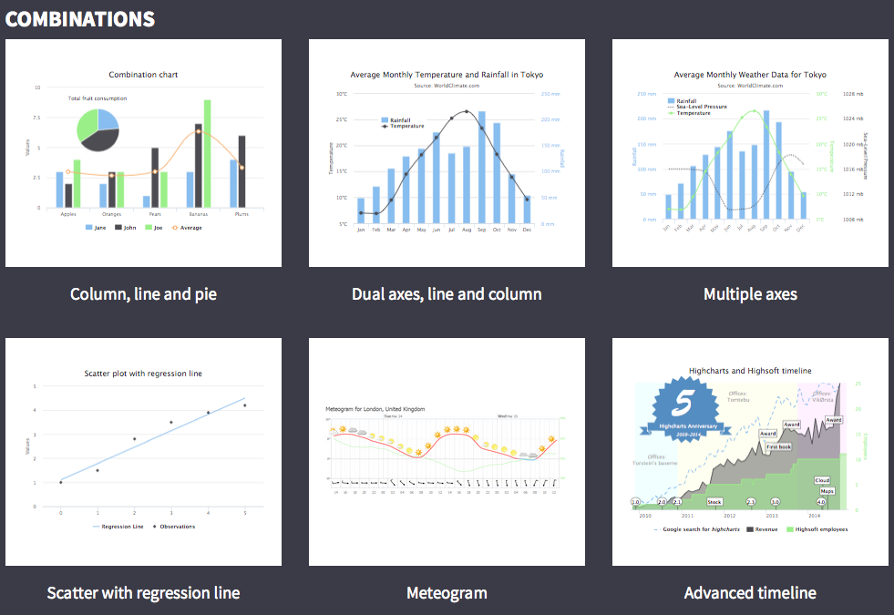
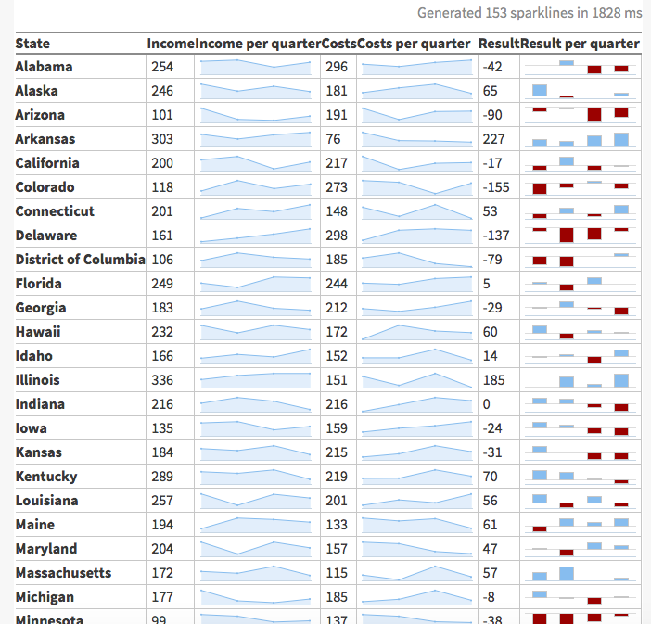
http://www.highcharts.com/demo

Slide 3
Biography
Used SAS for 31 years in Australia, U.K., Belgium & The Netherlands.
Involved in founding and running SAS user groups around the world.
Author of a book on SAS Tips & Techniques for SAS Publishing.
Author of many SAS courses, including Advanced Macro Programming for SAS Institute.
Written and presented many papers at SAS conferences.
Worked in Life Sciences, Financial Industry, Retail, Utilities, Government & Tele-communications.

Slide 4

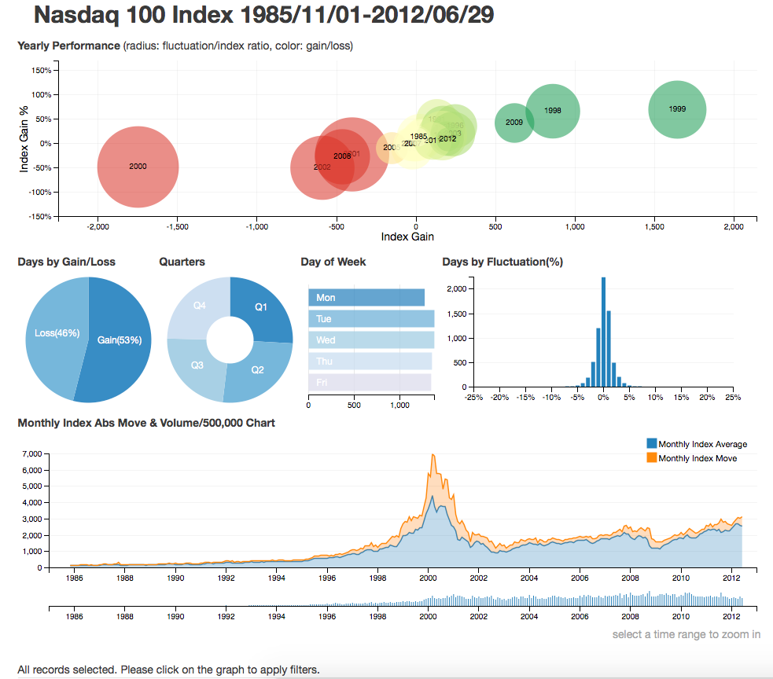
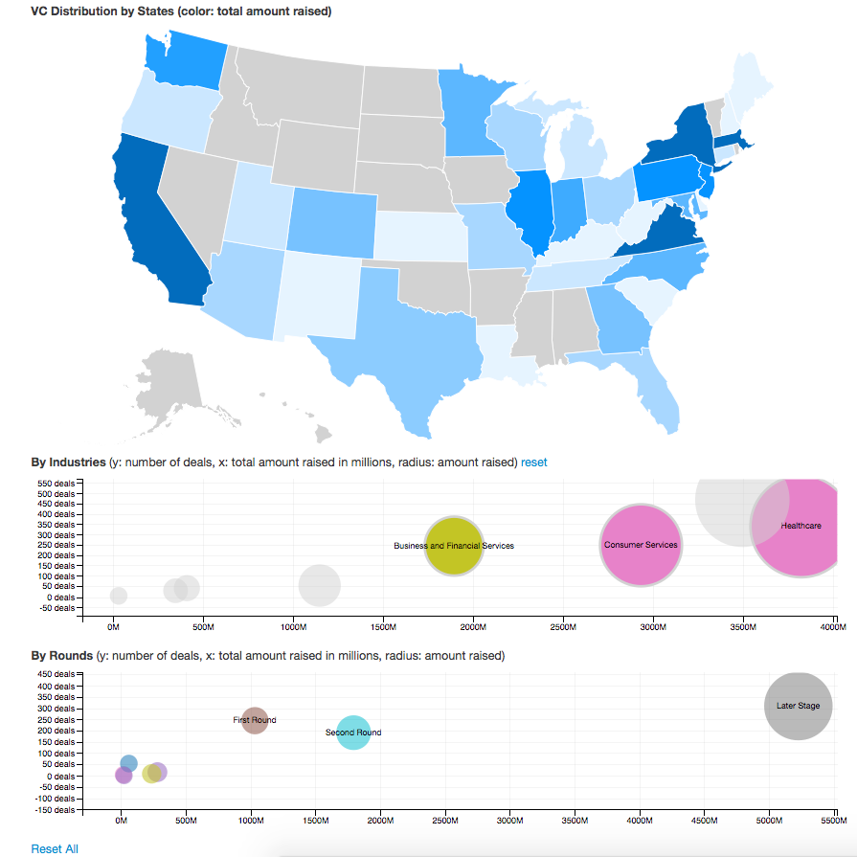
http://dc-js.github.io/dc.js/

Slide 5
CREATING AMAZING VISUALISATIONS WITH SAS® STORED PROCESSES AND JAVASCRIPT LIBRARIES
Phil Mason
Independent SAS Consultant
Did you know?
SAS University Edition includes the SAS 9.4 products Base SAS®, SAS/STAT®, SAS/IML®, SAS/ACCESS® Interface to PC Files, and SAS® Studio. Runs in a Virtual Machine on PC, Mac or Linux. And you can download it for FREE!!!
http://www.sas.com/en_us/software/university-edition.html
Notes:
SAS University Edition is Free!
Little puzzles in bottom right corner will show up now and then

Slide 6
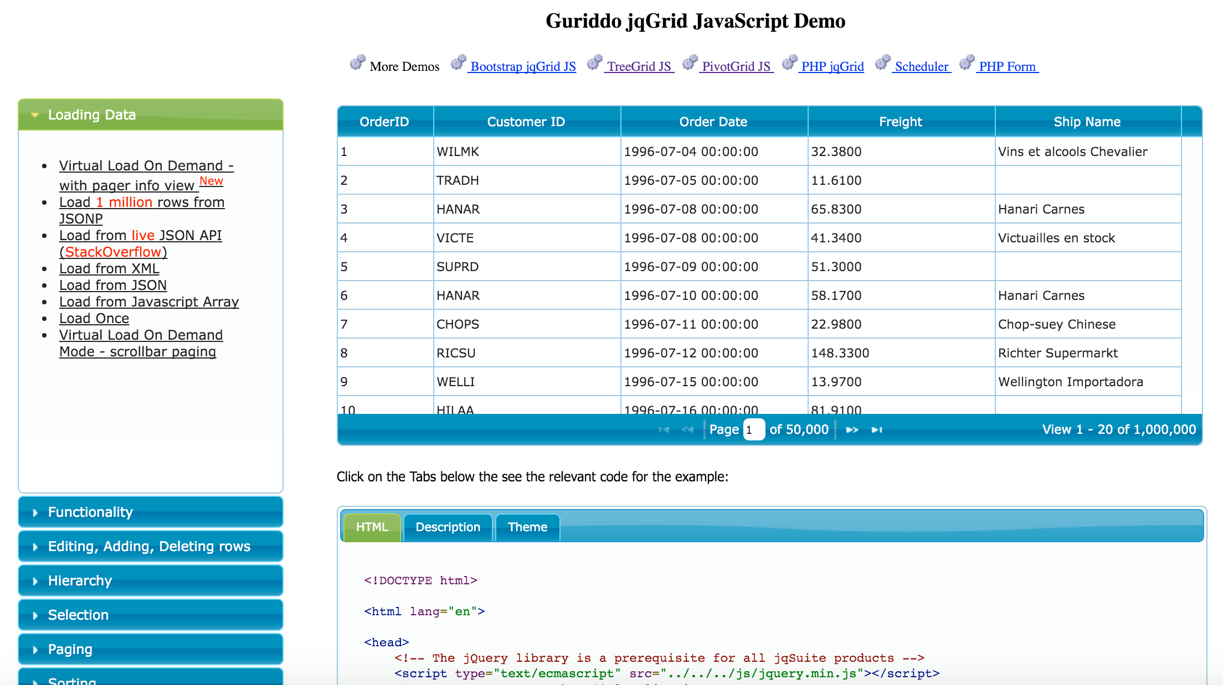
http://www.guriddo.net/demo/guriddojs/

Slide 7
Biography
Used SAS for 31 years in Australia, U.K., Belgium & The Netherlands.
Involved in founding and running SAS user groups around the world.
Author of a book on SAS Tips & Techniques for SAS Publishing.
Author of many SAS courses, including Advanced Macro Programming for SAS Institute.
Written and presented many papers at SAS conferences.
Worked in Life Sciences, Financial Industry, Retail, Utilities, Government & Tele-communications.

Slide 8
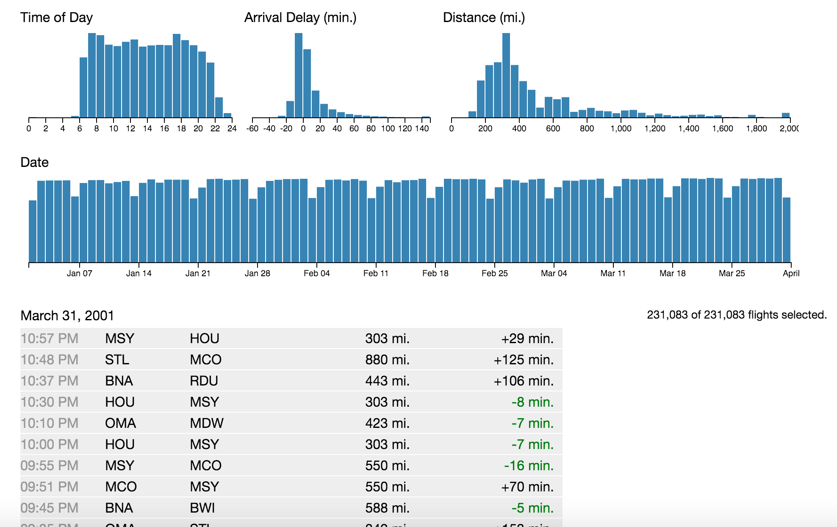
http://square.github.io/crossfilter/

